Slide 1
Case Study: Global Sales Analysis for NorthWind Traders
Gina Mastrorilli, Kaitlyn Borski & Nabila Hoor Un Ein

Slide 2
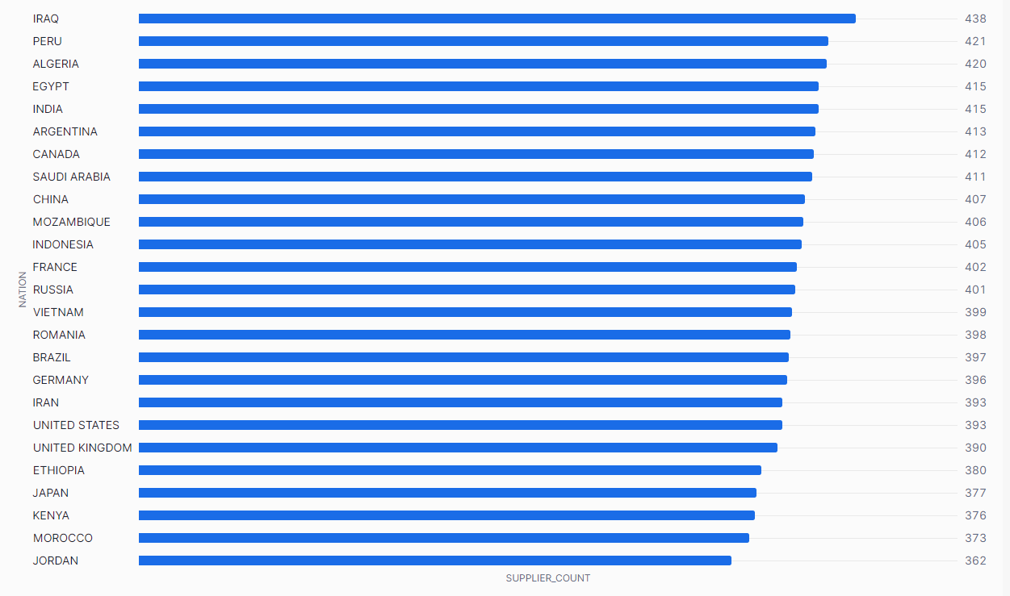
Supplier Diversity
Top 3 Nations : Iraq, Peru & Algeria
Top 13 Nations all have over 400 Suppliers
Lowest Nation: Jordan with 362 Suppliers

Slide 3
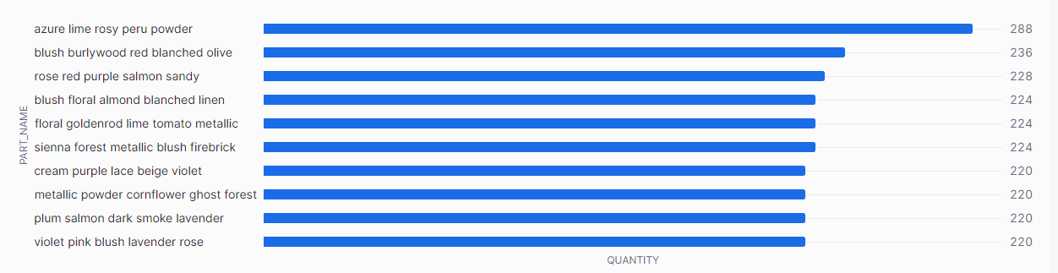
Top Performing Products
Top Product Sold: Azure Lime Rosy Peru Power
Top 10 Products all have a Quantity over 220
Lowest Product Quantity sold is 36 (Gainsboro Violet Chocolate Firebrick Red)
Top 10 Performing Products

Slide 4
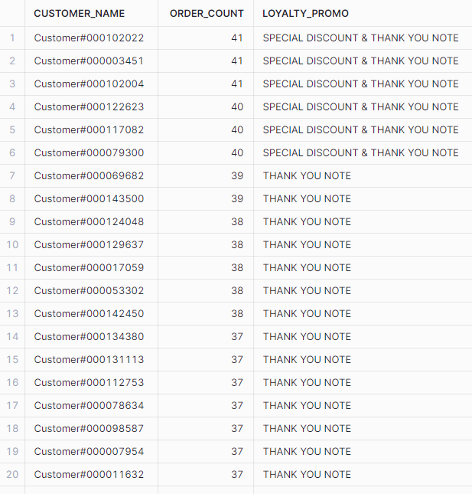
Customer Loyalty
30% of Top Customers have over 40 Orders
Top 20 Customers all have over 35 orders
Loyalty Promotion
Over 40 Orders:
Special Discount
Thank you Note
Over 37 Orders
Thank you Note
Average Order Count is 15 Orders per customer

Slide 5
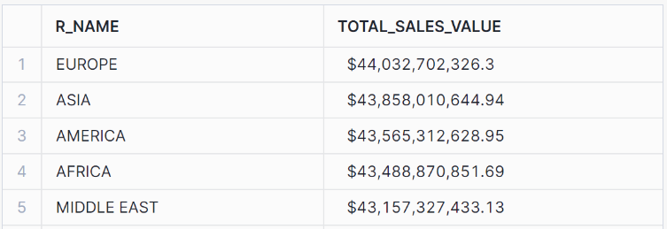
Total Sales Value for each Region
Europe has the highest total sales value
All regions are doing well, with total sales values around $43 - $44 billion

Slide 6
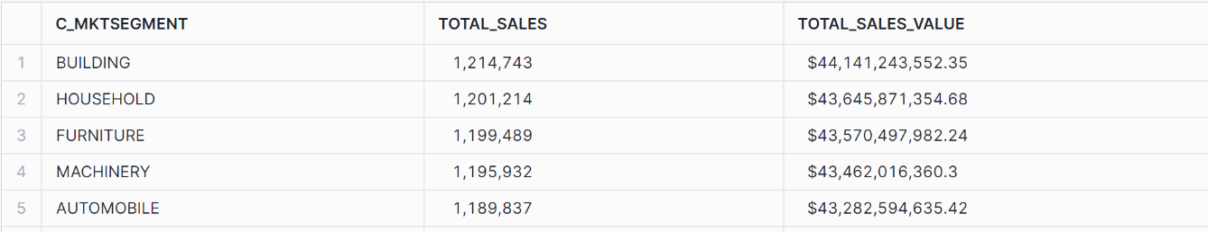
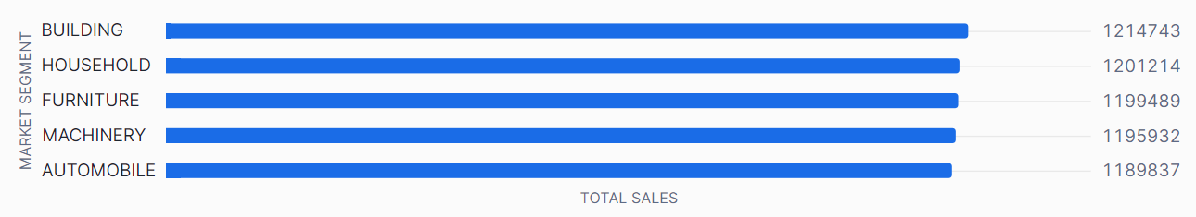
Total Sales for each Market Segment
The “BUILDING” and “HOUSEHOLD” market segments have been doing exceptionally well. However, the “AUTOMOBILE” market segment has the least amount of sales

Slide 7
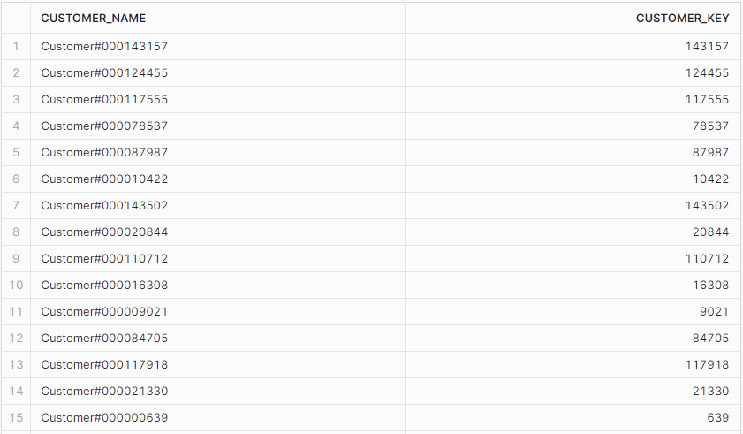
Customers who haven’t placed any orders
About 1 in 3 customers have not placed any orders at NorthWind Traders

